Slide 1
UNIT 3

Slide 2
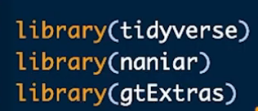
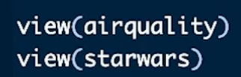
Handling Missing Values
Nanair –visualisation
gtExtras –create beautiful tables
(2068) Handling Missing Data and Missing Values in R Programming | NA Values, Imputation, naniar Package - YouTube

Slide 3
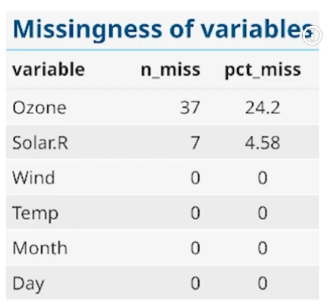
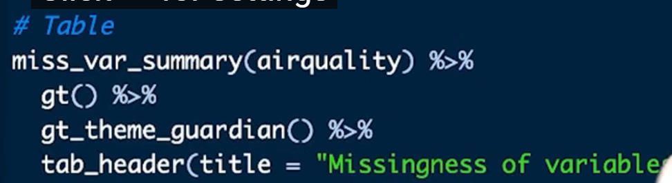
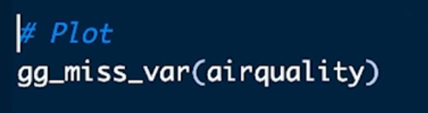

To get this
N_miss –no of missing values
Pct_miss-percentage of missing values
Vis_miss tells where the missing values are located in each variable in your dataset

Slide 4
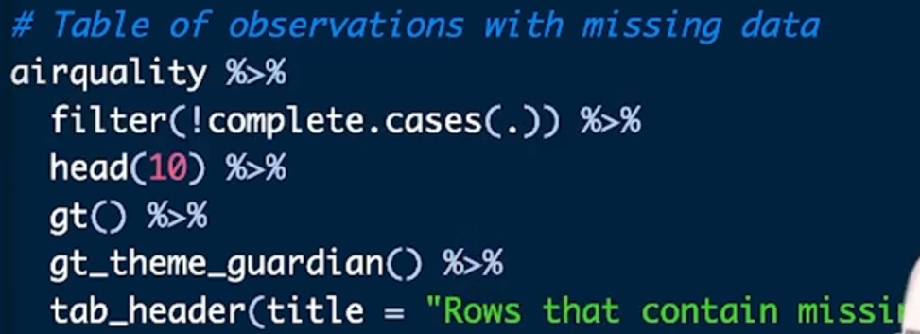
To get the birds eye view of the missing data

Slide 5
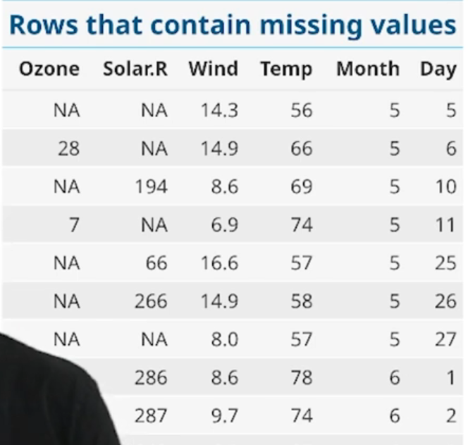

Slide 6
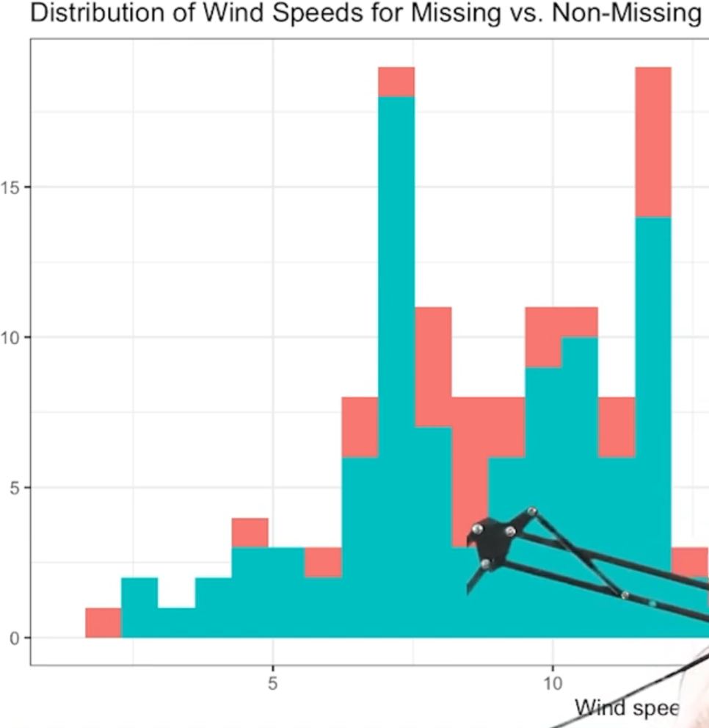
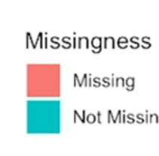
To check if the missing values in one variable is realted to missing values in other variables – checking is missingness is random or not
Eg missing values in ozone is related to wind

Slide 7
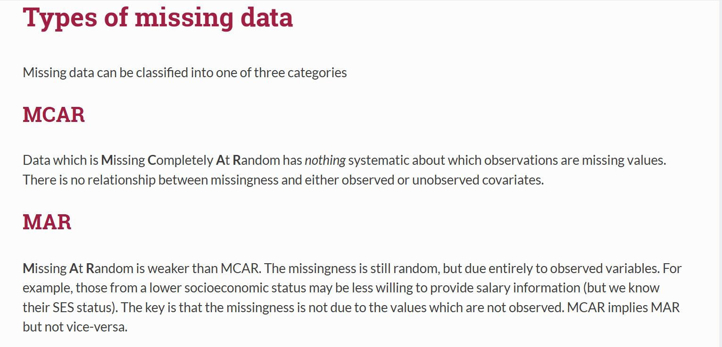
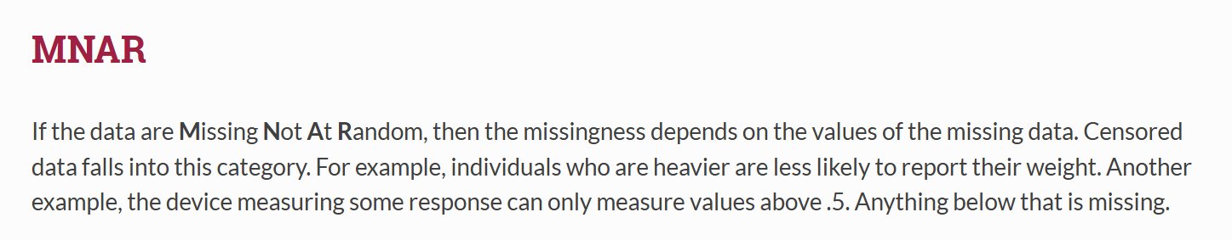
Multiple Imputation
Checking the relationship with other variables for missing and non-missing values" represents an Exploratory Data Analysis (EDA) step to determine if the absence of data (NA) is systematic or random.
It helps identify if missingness is related to other variables, which dictates whether data is Missing Completely at Random (MCAR), Missing at Random (MAR), or Missing Not at Random (MNAR).
In R, this is done by creating indicator variables (1 for missing, 0 for observed) and comparing them against other features.

Slide 8
What This Process Represents
MAR/MNAR Diagnosis: It determines if a variable (e.g., 'Salary') is missing more frequently when another variable (e.g., 'Gender' or 'Age') has certain values.
Data Cleaning Strategy: It tells you if you can safely remove rows (MCAR) or if you need advanced imputation (MAR/MNAR).

Slide 9
A. Visualizing Missingness Patterns (naniar) This helps see if missing values in one column correlate with values in another.
# Install and load required packages
install.packages(c("naniar", "ggplot2"))
library(naniar)
library(ggplot2)
# Visualize missingness across the dataset
vis_miss(airquality)
# Check if missingness in 'Ozone' is related to 'Solar.R‘
ggplot(airquality, aes(x = Solar.R, y = Ozone)) + geom_miss_point()

Slide 10

The table compares the observed characteristics (Solar.R, Wind, Temp) between two groups:
Group 1: Where Ozone is observed (Not missing)
Group 2: Where Ozone is missing
If missingness were related to these other variables, their means would differ significantly between groups. In this table:
All p-values > 0.05
No strong evidence that Solar.R, Wind, or Temp differ when Ozone is missing vs. not missing.

Slide 11
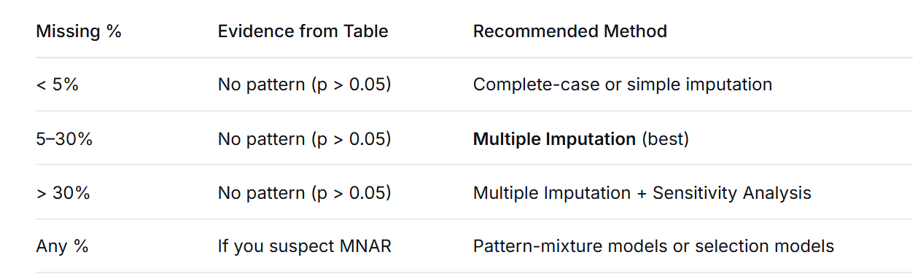

Slide 12
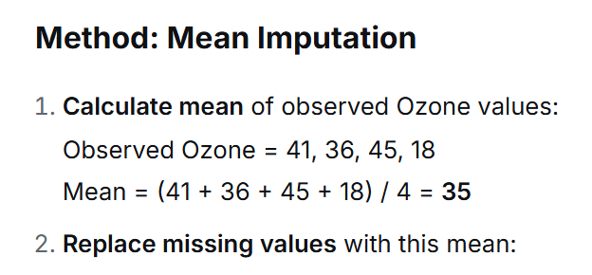
SIMPLE IMPUTATION (Single Value Replacement)

Slide 13
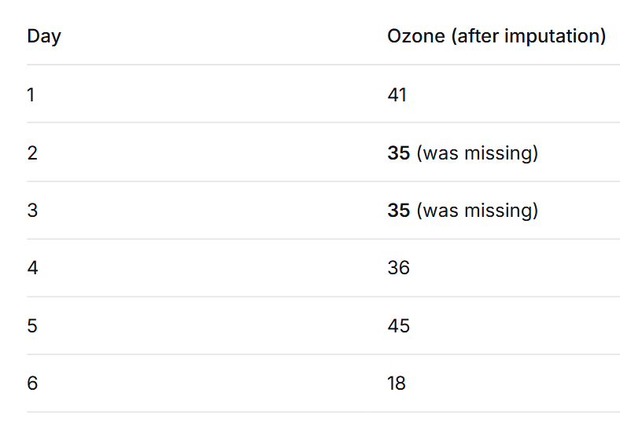

Slide 14
Multiple Imputation
Traditional methods (like mean imputation) give you one guess for each missing value.
But that's overconfident — we don't know the true values, we're just making educated guesses.
Instead of one guess, let's make several reasonable guesses that reflect our uncertainty.

Slide 15
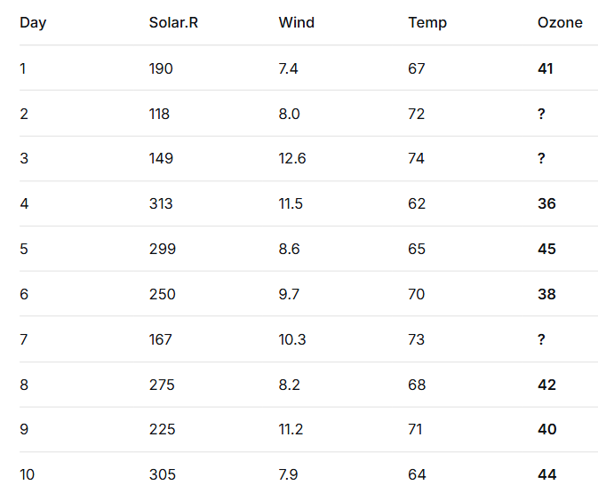

Slide 16
Step 1: Build a Prediction Model
Using only complete cases (where Ozone is observed):
Run regression:
Ozone = β₀ + β₁×Solar.R + β₂×Wind + β₃×Temp + error
Get:
Parameter estimates (β's)
Residual variance (σ²) - how much Ozone varies around predictions

Slide 17
Step1:ANALYZE 7 COMPLETE CASES
Regression results
β₀ = 12.5
β₁ = 0.18 (SE = 0.05, Variance = 0.0025)
β₂ = -1.3 (SE = 0.3, Variance = 0.09)
β₃ = 0.7 (SE = 0.15, Variance = 0.0225)
Variance-covariance matrix V (4×4):
β₀ β₁ β₂ β₃
β₀ [ 6.25 0.01 -0.15 0.08 ]
β₁ [ 0.01 0.0025 -0.005 0.002 ]
β₂ [-0.15 -0.005 0.09 -0.04 ]
β₃ [ 0.08 0.002 -0.04 0.0225 ]

Slide 18
1.2 Calculate σ²:
Residuals from 7 complete cases: -2.1, 1.8, -1.9, 0.7, 1.2, -0.8, 1.1
SSE = (-2.1)² + 1.8² + (-1.9)² + 0.7² + 1.2² + (-0.8)² + 1.1²
= 4.41 + 3.24 + 3.61 + 0.49 + 1.44 + 0.64 + 1.21
= 15.04
n = 7, p = 3
σ² = SSE / (n - p - 1) = 15.04 / (7-3-1) = 15.04 / 3 = 5.013
σ = √5.013 = 2.24
So: Ozone varies ±2.24 units around predictions after accounting for Solar.R, Wind, Temp.

Slide 19
STEP 2: CREATE M=3 DATASETS
PARAMETERS FOR DRAWING:
ν = n - p - 1 = 7-3-1 = 3 (degrees of freedom)
σ² = 5.013
β = [12.5, 0.18, -1.3, 0.7]
V = variance-covariance matrix above

Slide 20
DATASET 1 CREATION:
2.1.1 Draw new β*₁:
From: β* ~ MVN(β, V)
Draw: β*₁ = [13.2, 0.16, -1.4, 0.65]
2.1.2 Draw new σ²*₁:
From: σ²* ~ (ν × σ²) / χ²(ν)
Draw χ² with ν=3: say, χ² = 4.2

Slide 21
Step 2: The First Imputation - Adding Proper Uncertainty
For each missing Ozone value (say, Day 2: Solar.R=118, Wind=8, Temp=72):
1. Make prediction:
Predicted Ozone = 10 + 0.2×118 + (-1.5)×8 + 0.8×72
= 10 + 23.6 - 12 + 57.6
= 79.2

Slide 22
Instead of using 79.2, we add two types of randomness:
A) Parameter uncertainty (we don't know β's exactly):
Our estimated β₁ = 0.2, but true value might be 0.18 or 0.22
So we draw new β's from their sampling distribution
Say we draw: β₀*=11, β₁*=0.19, β₂*=-1.6, β₃*=0.7
B) Prediction error (individual variability):
Even with perfect β's, predictions aren't perfect
Draw random error from N(0, σ²) where σ² is slightly inflated

Slide 23
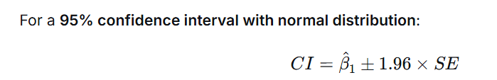
A 95% confidence interval (CI) is a range of values that is estimated to contain the true population parameter (like a mean, proportion, or regression coefficient) with 95% probability, based on a sample from that population.
95% Confidence Interval with a normal distribution, the critical value is always 1.96.
β₀ β₁ β₂ β₃
β₀ [ 4.0 0.1 -0.3 0.2 ]
β₁ [ 0.1 0.01 -0.02 0.005]
β₂ [ -0.3 -0.02 0.25 -0.1 ]
β₃ [ 0.2 0.005 -0.1 0.16 ]
β₁ variance = 0.01 → SD = √0.01 = 0.1
So β₁ = 0.2(coeff value) ± 0.2 (95% CI roughly)=1.96*0.1(SD) =.196
95% of draws will fall between: 0.2 ± 1.96×0.1 = 0.004 to 0.396
Approximately: 0.0 to 0.4
Like this do for all βi
So the range ±0.2 gives you a sense of how much β₁ might vary across imputed datasets

Slide 24
For Dataset 1: We draw: [β₀, β₁, β₂, β₃] ~ MVN(β, V) Where:
β = [10, 0.2, -1.5, 0.8] (our estimates)
V = the 4×4 covariance matrix above
Result might be: β* = [11, 0.19, -1.6, 0.7]

Slide 25
random error
1. Run the regression:
Ozone ~ Solar.R + Wind + Temp
2. Get residuals:
For each complete case: Residual = Actual Ozone - Predicted Ozone
Example:
Day 1: Actual=41, Predicted=44 → Residual = -3
Day 4: Actual=36, Predicted=32 → Residual = +4
Day 5: Actual=45, Predicted=47 → Residual = -2
3. Calculate σ² (formula):
σ² = SSE / (n - p - 1) Where:
SSE = Sum of Squared Errors = Σ(residualᵢ)²
n = number of complete cases
p = number of predictors (3: Solar.R, Wind, Temp)

Slide 26
STEP 2: THE DISTRIBUTION OF σ²
Here's the key insight: σ² itself has uncertainty!
Just like β's have sampling distributions, σ² has a sampling distribution too.
If the true errors are normally distributed, then:
(n - p - 1) × σ² / true_σ² ~ χ²(n - p - 1)
What Inverse-χ² means:
It's a Chi-Squared distribution that gives us plausible values of σ² given our data.
A distribution of squared values
Always positive (squares can't be negative)
Skewed to the right (not symmetric like normal)
Defined by degrees of freedom (df)

Slide 27
We had:
ν = 16 (degrees of freedom = n - p - 1)
σ² = 25 (our estimate from data)
We need to draw a new σ²*
σ²* ~ (ν × σ²) / χ²(ν)
These σ²* can be true value,smaller or larger → we need it to follow a distribution –chi squared distribution – that it must be having 95% confidence interval that the values must lie in that range of the distribution

Slide 28
So we need to draw from χ²(16).
HOW TO "DRAW" A χ²(16) VALUE:
For a χ² distribution with k degrees of freedom:
6.91 is the 2.5th percentile (α = 0.025)
28.85 is the 97.5th percentile (α = 0.975)
For k = 16 degrees of freedom:
P(χ²(16) < 6.91) = 0.025
P(χ²(16) < 28.85) = 0.975

Slide 29
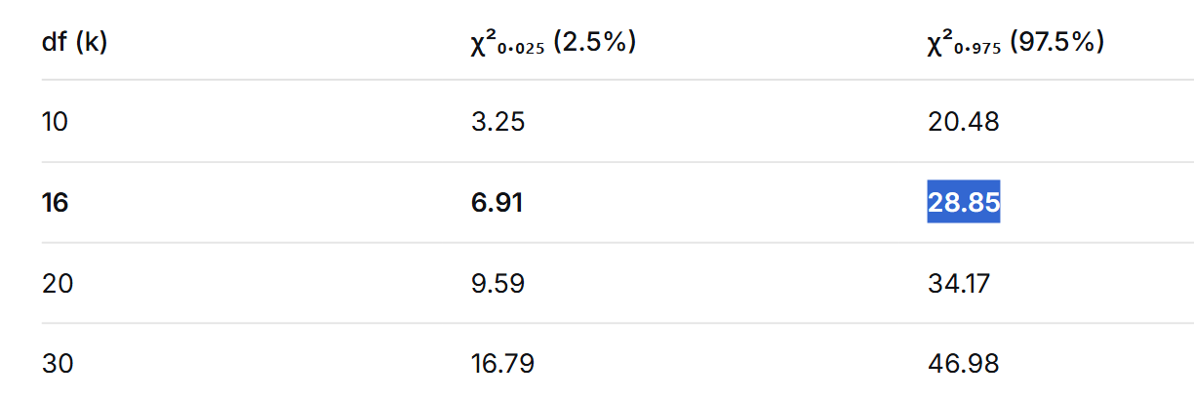
qchisq(0.025, df=16) # 6.907664
qchisq(0.975, df=16) # 28.84535

Slide 30
To find variance for m sets
n <- nrow(complete_cases)
p <- 3
nu <- n - p – 1
SSE <- sum(residuals(model)^2)
sigma_sq <- SSE / nu
# Calculate 97.5% CI for σ²
alpha <- 0.025
# For 97.5% CI, alpha = 0.025 (2.5% in each tail)#We want the 2.5th percentile This is the lower critical value that cuts off 2.5% of left
tailchi_lower <- qchisq(alpha/2, df = nu)
#We want the 97.5th percentile This is the upper critical value that cuts off 2.5% of right
tailchi_upper <- qchisq(1 - alpha/2, df = nu)
sigma2_lower <- (nu * sigma_sq) / chi_uppe
rsigma2_upper <- (nu * sigma_sq) / chi_lower

Slide 31
METHOD: Generate m variances uniformly within CI
variances <- runif(m, min = sigma2_lower, max = sigma2_upper)
variancescat("=== GENERATED VARIANCES (3 sets) ===\n")
for(i in 1:m)
{ cat(sprintf("Set %d: σ² = %.4f (σ = %.4f)\n", i, variances[i], sqrt(variances[i])))

Slide 32
WHY THE VALUES VARY:
Our draws give:
Dataset 1: σ²* = 19.5 (σ* = 4.42) — less variation
Dataset 2: σ²* = 28.2 (σ* = 5.31) — more variation
Dataset 3: σ²* = 22.5 (σ* = 4.74) — moderate variation
This makes sense! We're saying:
"Maybe the true variation is smaller (σ=4.4)"
"Or maybe it's larger (σ=5.3)"
"We're not sure, so we'll consider multiple possibilities"

Slide 33
Calculate imputed value:
New prediction with drawn
β's = 11 + 0.19×118 + (-1.6)×8 + 0.7×72 = 78.4
Add random error (drawn from N(0, 6²)) = -2.3
Final imputed value = 78.4 - 2.3 = 76.1
Repeat for all missing values → Dataset 1 complete
σ²=

Slide 34
Substep 3.3: Impute Each Missing Value Again
Day 2:
Prediction = 14.1 + 0.16×118 + (-1.1)×8 + 0.65×72
= 14.1 + 18.88 - 8.8 + 46.8
= 70.98
Random error: e = -1.5
Imputed = 70.98 - 1.5 = 69.48 ≈ 69

Slide 35
Day 3:
Prediction = 14.1 + 0.16×149 + (-1.1)×12.6 + 0.65×74
= 14.1 + 23.84 - 13.86 + 48.1
= 72.18
Random error: e = 1.8
Imputed = 72.18 + 1.8 = 73.98 ≈ 74
Dataset 2 Complete:
Day 2 Ozone = 69
Day 3 Ozone = 74
Do the same for dataset 3 also
You don't choose "the best" dataset — you use all of them to get an honest answer that says: "Given the missing data, here's our best estimate ± appropriate uncertainty."

Slide 36
Step 1: Create m Imputed Datasets ✓
You fill in missing values m different ways → m complete datasets
Step 2: Analyze EACH Dataset ✓
Run regression on each dataset → Get m sets of parameters
Step 3: POOL the Parameters ✓
Combine the m parameter sets → Get ONE set of pooled parameters

Slide 37
Pooling in Multiple Imputation: The Why and How
What is Pooling?
Pooling is the statistical process of combining results from multiple imputed datasets to produce a single set of estimates that properly accounts for the uncertainty introduced by missing data.
Without Pooling: You'd report 3 different results (confusing!)
With Pooling: You report 1 combined result with proper uncertainty
Analogy:
Imagine you're trying to estimate the average height in a population, but some people didn't show up for measurement.
Take m different educated guesses about the missing heights
Create m complete datasets
Calculate the average height for each dataset
Combine these m averages into one final estimate
Pooling is step 4 - it's how we combine those m different estimates.

Slide 38
Step 1: Gather Results from All Datasets
We take each of the 3 completed datasets you created and run the same analysis (regression) on each one.
We save:
The coefficients (slopes) from each regression
The standard errors (measure of uncertainty) from each regression
This gives us 3 sets of answers to the same question.

Slide 39
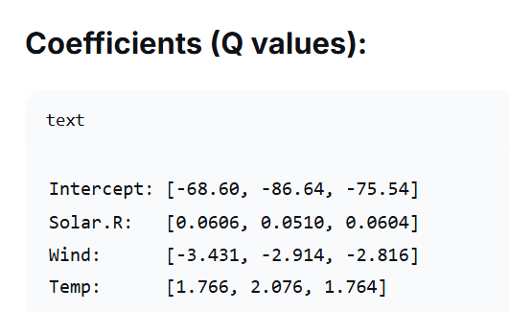
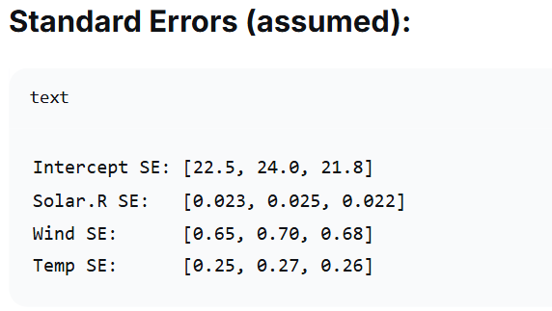
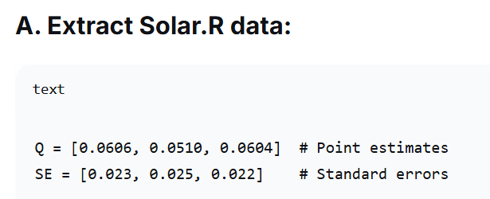

Slide 40
Step 2: Apply Rubin's Rules for Each Parameter
A. Calculate the average estimate (Q̄):
Take the 3 estimates from the 3 datasets
Average them → This becomes our final best guess
B. Calculate "within" variance (Ū):
Square each standard error (SE² = variance)
Average these variances
This measures: How uncertain are we even with complete data?

Slide 41
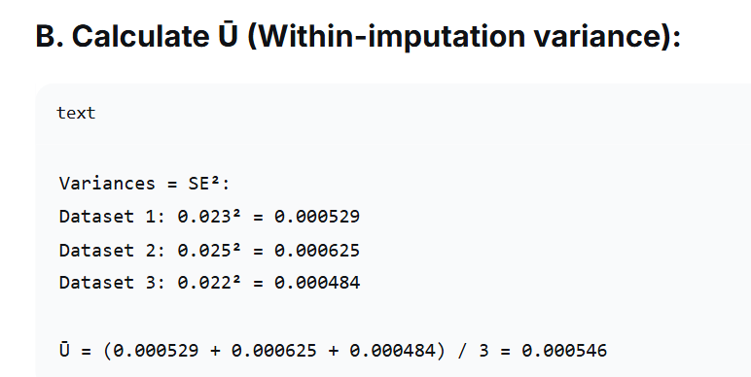

Slide 42
C. Calculate "between" variance (B):
Look at how much the 3 estimates differ from their average
Calculate the variance of these 3 estimates
This measures: How much does our answer change depending on how we filled in missing values?

Slide 43
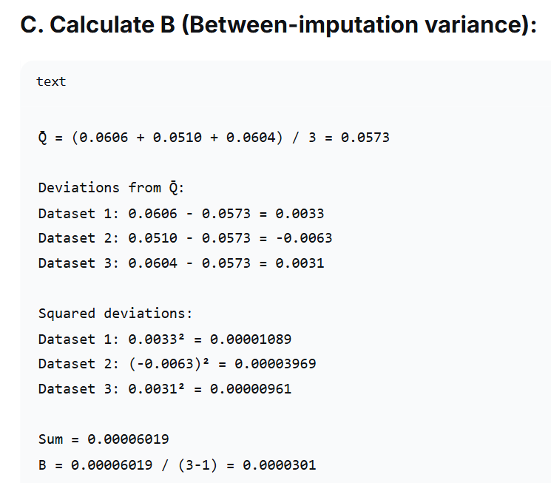

Slide 44
D. Combine uncertainties (T):
Total variance = Within variance + (1 + 1/3) × Between variance
The (1 + 1/3) factor says: "Between variance itself is uncertain because we only did 3 imputations"

Slide 45
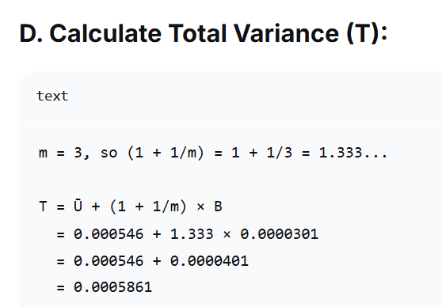
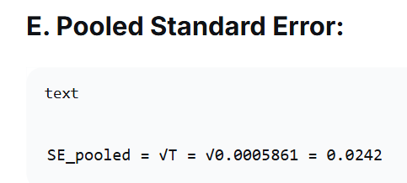
Do this for all parameters

Slide 46
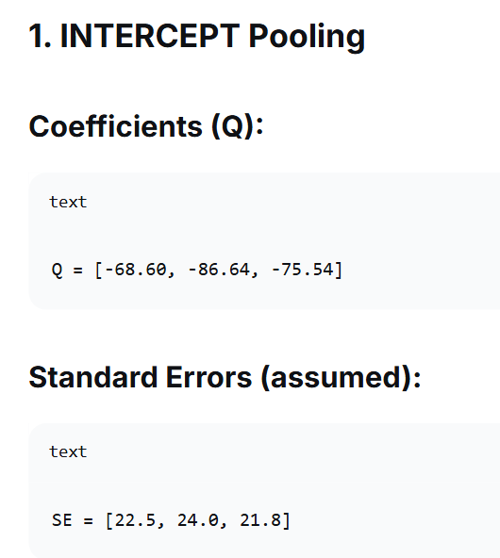

Slide 47
1. Point estimate (Q̄) = (-68.60 - 86.64 - 75.54)/3 = -230.78/3 = -76.93
2. Within variance (Ū):
Variances = SE² = [506.25, 576.00, 475.24]
Ū = (506.25 + 576.00 + 475.24)/3 = 1557.49/3 = 519.16
3. Between variance (B):
Deviations: [-68.60 - (-76.93) = 8.33,
-86.64 - (-76.93) = -9.71,
-75.54 - (-76.93) = 1.39]
Squared: [69.39, 94.28, 1.93]
Sum = 165.60
B = 165.60/(3-1) = 82.80
4. Total variance (T):
T = Ū + (1 + 1/3) × B = 519.16 + 1.333 × 82.80
= 519.16 + 110.40 = 629.56
5. Pooled SE:
SE_pooled = √629.56 = 25.09

Slide 48
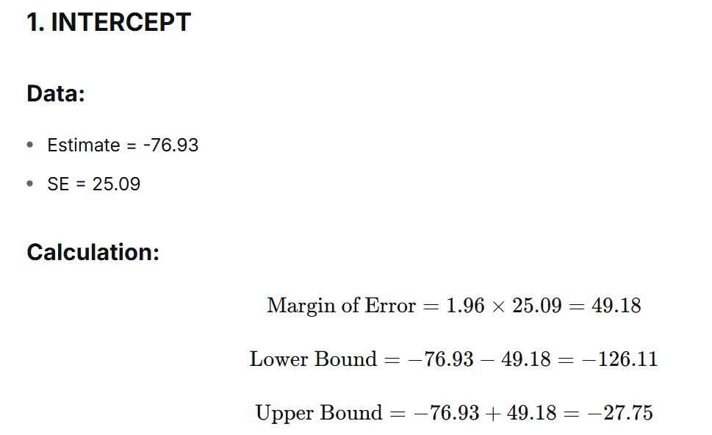
95% CI: (-126.11, -27.75)
INTERPRETATION OF EACH CI:
Intercept (-126.11, -27.75):
We're 95% confident the true intercept (predicted Ozone when Solar.R=0, Wind=0, Temp=0) is between -126.11 and -27.75

Slide 49
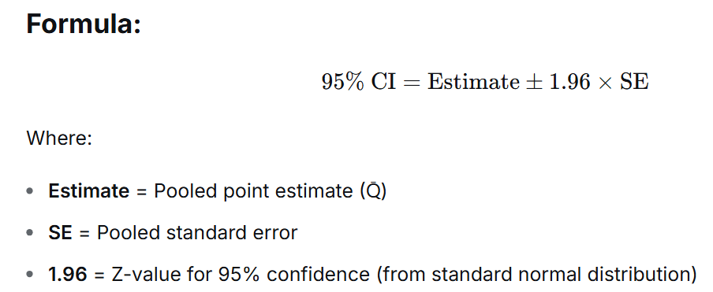
95% CI Calculation for Each Parameter

Slide 50
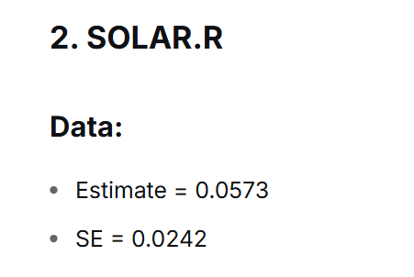
1.96 × 0.0242 = 0.047432 ≈ 0.0474
0.0573 - 0.0474 = 0.0099
0.0573 + 0.0474 = 0.1047
Solar.R (0.0099, 0.1047):
Each 1-unit increase in Solar.R increases Ozone by 0.01 to 0.10 units

Slide 51
3. WIND Pooling
Q = [-3.431, -2.914, -2.816]
Err
SE = [0.65, 0.70, 0.68]
1. Q̄ = (-3.431 - 2.914 - 2.816)/3 = -9.161/3 = -3.054
2. Ū:
Variances = [0.4225, 0.4900, 0.4624]
Ū = (0.4225 + 0.4900 + 0.4624)/3 = 1.3749/3 = 0.4583
3. B:
Deviations: [-3.431 - (-3.054) = -0.377,
-2.914 - (-3.054) = 0.140,
-2.816 - (-3.054) = 0.238]
Squared: [0.1421, 0.0196, 0.0566]
Sum = 0.2183
B = 0.2183/2 = 0.1092
4. T:
T = 0.4583 + 1.333 × 0.1092 = 0.4583 + 0.1456 = 0.6039
5. SE_pooled = √0.6039 = 0.777

Slide 52
1.96 × 0.777 = 1.52292 ≈ 1.523
-3.054 - 1.523 = -4.577
-3.054 + 1.523 = -1.531
95% CI: (-4.577, -1.531)

Slide 53
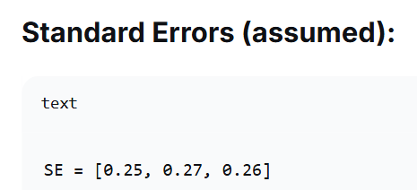
TEMP Pooling
Q = [1.766, 2.076, 1.764]

Slide 54
1. Q̄ = (1.766 + 2.076 + 1.764)/3 = 5.606/3 = 1.869
2. Ū:
Variances = [0.0625, 0.0729, 0.0676]
Ū = (0.0625 + 0.0729 + 0.0676)/3 = 0.2030/3 = 0.0677
3. B:
Deviations: [1.766 - 1.869 = -0.103,
2.076 - 1.869 = 0.207,
1.764 - 1.869 = -0.105]
Squared: [0.0106, 0.0428, 0.0110]
Sum = 0.0644
B = 0.0644/2 = 0.0322
4. T:
T = 0.0677 + 1.333 × 0.0322 = 0.0677 + 0.0429 = 0.1106
5. SE_pooled = √0.1106 = 0.333

Slide 55
1.96 × 0.333 = 0.65268 ≈ 0.653
1.869 - 0.653 = 1.216
1.869 + 0.653 = 2.522
95% CI: (1.216, 2.522)

Slide 56
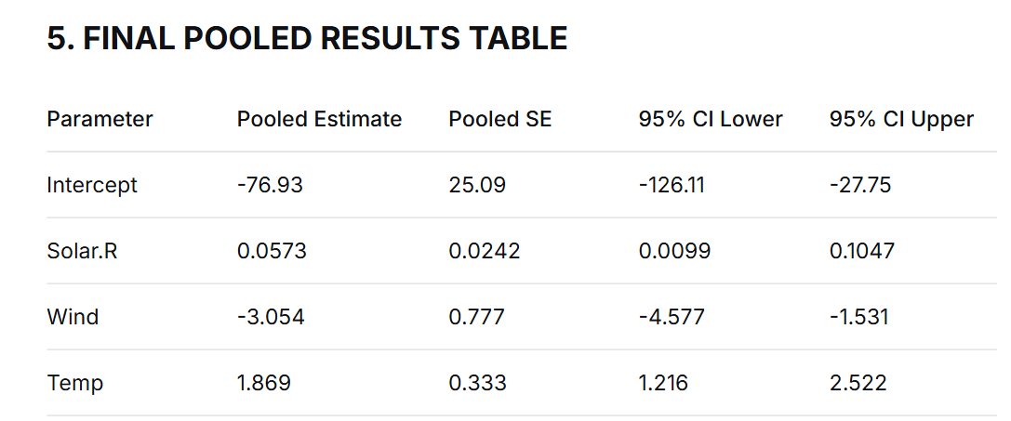

Slide 57
E. Calculate final standard error:
Square root of total variance → Back to original units
This is our honest uncertainty accounting for both sampling error AND imputation uncertainty

Slide 58
Step 4: Calculate Confidence Intervals
For each parameter:
Lower bound = Estimate - (1.96 × Standard Error)
Upper bound = Estimate + (1.96 × Standard Error)
This gives us a 95% confidence interval: "We're 95% confident the true value is in this range"

Slide 59
What This Accomplishes:
Without pooling: You'd have to report 3 different answers and wouldn't know which one is "right."
With pooling: You get one combined answer that:
Uses all available information (all 3 datasets)
Honestly acknowledges: "My imputations were guesses, so I'm less certain"
Gives you valid statistical tests and confidence intervals

Slide 60
How to use the pooled model?
# New days to predict
new_days <- data.frame(
Solar.R = c(150, 200, 250, 300),
Wind = c(8, 10, 12, 15),
Temp = c(70, 75, 80, 85)
)
# Make predictions
new_days$Predicted_Ozone <- predict_ozone(new_days$Solar.R,
new_days$Wind,
new_days$Temp)
# Add approximate 95% prediction intervals
sigma <- 21.21 # From your average residual SD (got from the m imputed datasets)
new_days$Lower_95 <- new_days$Predicted_Ozone - 1.96 * sigma
new_days$Upper_95 <- new_days$Predicted_Ozone + 1.96 * sigma
new_days$Lower_95 <- pmax(0, new_days$Lower_95) # Can't be negative
print(new_days)

Slide 61
Final pooled model evalution from imputed dataset
Create One "Averaged" Dataset
Take the average of imputed values across all m datasets:
text
For each missing Ozone value: Take its value from Dataset 1, Dataset 2, ..., Dataset m Average them
This gives you one complete dataset that represents the "consensus" imputation.

Slide 62
Use your final pooled coefficients to predict Ozone for ALL observations (including originally missing ones):
Predicted Ozone = (-76.93) + (0.0573)×Solar.R + (-3.054)×Wind + (1.869)×Temp
Step 3: Calculate Apparent Accuracy
Compare predictions against the averaged complete data:
RMSE = Root Mean Square Error (how far off predictions are)
R² = Proportion of variance explained
Apply Optimism Adjustment
Since you're testing on the same data used for imputation, accuracy is over-optimistic. Apply a simple adjustment:
Adjusted R² = Apparent R² × 0.85 (reduce by 15%) Adjusted RMSE = Apparent RMSE × 1.10 (increase by 10%)

Slide 63
Handling Multiple Missing Variables Simultaneously
When Ozone is missing AND other predictors are also missing, you need a joint imputation approach. Here's how:
1. The Problem
Your airquality data has missing values in:
Ozone (37 missing) ← Your target variable
Solar.R (7 missing) ← Predictor variable
If you try to predict missing Ozone using Solar.R, but Solar.R is also missing for the same observation → CAN'T USE THAT ROW!
2. The Solution: Impute ALL Missing Variables Together
Approach A: MICE (Multiple Imputation by Chained Equations) - RECOMMENDED

Slide 64
Exercise
# Task 1.1: Load the COVID-19 dataset from GitHub
# URL: https://raw.githubusercontent.com/CSSEGISandData/COVID-19/master/csse_covid_19_data/csse_covid_19_daily_reports/01-01-2021.csv
# Expected issues in real data:
# - Mixed character/numeric in numeric columns
# - Inconsistent date formats
# - Missing values coded as "", "NA", "N/A", or just empty
# - Inconsistent country/region names
# - Column type mismatches
Compute Overall missing values
Column-wise NA counts
Percentage of missing values per column
Create summary dataframe
Sort attributes by most missing
Print problematic columns "Columns with >20% missing values”
Rows with most missing values

Slide 65
Handle NA
# Create a vector with various NA patterns and values
my_vector <- c(
10, # Normal value
NA, # Standard NA (missing numeric)
25, # Normal value
NA_real_, # Explicit numeric NA
40, # Normal value
NA_integer_, # Explicit integer NA
55, # Normal value
NA_character_, # Explicit character NA
70, # Normal value
NA, # Standard NA
85 # Normal value
)
# Display the vector
print(my_vector)
# Output: [1] 10 NA 25 NA 40 NA 55 NA 70 NA 85

Slide 66
How to Identify NA Values
# Check for NA values
is.na(my_vector)
# Output: [1] FALSE TRUE FALSE TRUE FALSE TRUE FALSE TRUE FALSE TRUE FALSE
# Count NA values
sum(is.na(my_vector))
# Output: 5
# Get positions of NA values
which(is.na(my_vector))
# Output: [1] 2 4 6 8 10
# Percentage of NA values
mean(is.na(my_vector)) * 100
# Output: 45.45% (5 out of 11)

Slide 67
Filling NA Values
Replace with a Constant Value
# Replace all NA with 0
vector_zero <- my_vector
vector_zero[is.na(vector_zero)] <- 0
# Output: [1] 10 0 25 0 40 0 55 0 70 0 85
# Replace with specific value
vector_99 <- my_vector
vector_99[is.na(vector_99)] <- 99
# Output: [1] 10 99 25 99 40 99 55 99 70 99 85
#Replace with mean
data$column_name[is.na(data$column_name)] <- mean(data$column_name, na.rm = TRUE)
# Output: [1] 10.0 47.5 25.0 47.5 40.0 47.5 55.0 47.5 70.0 47.5 85.0

Slide 68
Deleting NA Values
# Remove all NA values
clean_vector2 <- my_vector[!is.na(my_vector)]
# Output: [1] 10 25 40 55 70 85
# Check length difference
cat("Original length:", length(my_vector), "\n")
cat("Clean length:", length(clean_vector), "\n")
# Output: Original: 11, Clean: 6

Slide 69
Remove rows with NA values in any column
cleaned_data <- na.omit(data)
Remove rows with NA values in specific columns (using tidyr package)
install.packages("tidyr")
library(tidyr)
cleaned_data <- data %>% drop_na(column_name1, column_name2)

Slide 70
To drop columns with a high proportion of null or missing values (above a specific threshold) in R
# Example Data Frame (using base R creation)
df <- data.frame( A = c(1, 2, NA, 4, 5), B = c(NA, NA, 3, 4, 5),
C = c(1, 2, 3, 4, 5), D = c(NA, NA, NA, NA, 5))
# Define the threshold (e.g., 50%)
threshold <- 0.5#
Calculate the proportion of missing values for each column
missing_proportions <- colMeans(is.na(df))
# Identify which columns to keep (those below the threshold)
cols_to_keep <- names(df[missing_proportions <= threshold])
cols_to_keep
# Subset the data frame to keep only those columns
df_cleaned_base <- df[cols_to_keep]
# View the result
print(df_cleaned_base)

Slide 71
Imputing Missing Data (Filling In)

Slide 72
# Create a focused 2-column dataframe with various missing value patterns
set.seed(123)
two_column_df <- data.frame(
# Column 1: String values with various NA representations
customer_name = c(
"Alice Johnson", "Bob Smith", "NULL", "null",
"N/A", "n/a", "NaN", "nan", " ", "",
"Charlie Brown", "David Wilson", "Missing",
"Eve Davis", "unknown", "Frank Miller",
"Grace Lee", "Henry Taylor", "Ivy Chen", "Jack White"
),
# Column 2: Numeric values with NA, NaN, and text representations
transaction_amount = c(
1500.50, NA, 2300, NaN, # Standard NA and NaN
"N/A", "2,500.75", "nan", NA, # Text representations
1800.25, 3100, 1850.30, 2700, # Normal numbers
"NA", 1950.45, 3200.80, 2100, # Mixed with text NA
"null", 2850.90, "NaN" # More text representations
),
stringsAsFactors = FALSE
)

Slide 73
#' Clean 2-Column DataFrame with Mixed Missing Values
clean_two_columns <- function(df, col1_type = "character", col2_type = "numeric", report = TRUE) {
# Make a copy
cleaned <- df
# Step 1: Clean the first column
if (col1_type == "character") {
# For character columns
cleaned[[1]] <- as.character(cleaned[[1]])
# Define patterns to convert to NA
missing_patterns <- c("NULL", "null", "N/A", "n/a", "NA", "na",
"NaN", "nan", "Missing", "missing", "MISSING",
"Unknown", "unknown", "UNKNOWN")
# Convert to lowercase for case-insensitive matching
cleaned_lower <- tolower(trimws(cleaned[[1]]))
# Check against lowercase patterns
missing_patterns_lower <- tolower(missing_patterns)

Slide 74
# Convert patterns to NA
# Single check against all patterns
is_missing <- cleaned_lower %in% patterns_lower
# Replace all at once
cleaned[[1]][is_missing] <- NA_character_
# Handle empty strings and whitespace
cleaned[[1]][trimws(cleaned[[1]]) == ""] <- NA_character_
cleaned[[1]][grepl("^\\s*$", cleaned[[1]])] <- NA_character_

Slide 75
else if (col1_type == "numeric")
{ # For numeric columns # Remove commas first
cleaned[[1]] <- gsub(",", "", cleaned[[1]])
# Convert text missing patterns to NA before numeric conversion text_to_na_patterns <- c("NULL", "null", "N/A", "n/a", "NA", "na", "NaN", "nan", "Missing", "Unknown")
for (pattern in text_to_na_patterns)
{ cleaned[[1]][trimws(cleaned[[1]]) == pattern] <- NA_real_ }
# Convert to numeric (text becomes NA)
cleaned[[1]] <- suppressWarnings(as.numeric(cleaned[[1]])) }
# Clean with appropriate types
cleaned_two_cols <- clean_two_columns( df = two_column_df, col1_type = "character", # customer_name should be character col2_type = "numeric", # transaction_amount should be numeric report = TRUE )

Slide 76
Examine the data types of columns
For NULL/NA
1.Diagnose → 2. Standardize missing strings → 3. Convert types → 4. Handle NAs → 5. Validate

Slide 77
# Function to clean a DataFrame column with mixed NA/NULL issues
clean_dataframe_column <- function(df, column_name) {
# Get the column
col_data <- df[[column_name]]
# Step 1: Handle string "NULL" and empty strings
if (is.character(col_data)) {
# Convert all missing indicators to NA
col_data[col_data %in% c("", "NULL", "null", "NA", "N/A", "NaN")] <- NA
}
# Step 2: Convert to appropriate type
# Try numeric first, fall back to original if fails
converted <- suppressWarnings(as.numeric(col_data))
if (all(is.na(converted)) && !all(is.na(col_data))) {
# Not numeric, try date
converted <- as.Date(col_data)
if (all(is.na(converted))) {
# Keep as character
converted <- col_data
}
}

Slide 78
# Step 3: Handle remaining NAs (optional imputation)
if (is.numeric(converted)) {
# Impute with median for numeric columns
converted[is.na(converted)] <- median(converted, na.rm = TRUE)
}
# Update DataFrame
df[[column_name]] <- converted
return(df)
}
# Usage example
dirty_df <- data.frame(
id = 1:5,
salary = c("50000", "NULL", "65000", "", "72000"),
department = c("IT", "HR", "NULL", "Finance", "IT")
)
# Clean the salary column
clean_df <- clean_dataframe_column(dirty_df, "salary")
print(clean_df)

Slide 79
The cars data frame contains missing values in the Weight variable. Write an R code snippet to perform median imputation for these missing values, grouped by Country.
That is, replace each missing Weight value with the median Weight value of cars from the same country.

Slide 80
library(dplyr)
cars <- cars %>%
group_by(Country) %>%
mutate(Weight = ifelse(is.na(Weight),
median(Weight,
na.rm = TRUE), Weight)) %>% ungroup()

Slide 81
country_medians <- aggregate(Weight ~ Country, data = cars, FUN = function(x) median(x, na.rm = TRUE))
# Replace missing values
for (i in 1:nrow(cars))
{ if (is.na(cars$Weight[i]))
{ country_val <- cars$Country[i]
median_val <- country_medians$Weight[country_medians$Country == country_val]
cars$Weight[i] <- median_val
}
}

